Slide 1
SoundGPT
Make Your Sound Come True

Slide 2


MISSION STATEMENT
At OpenSound, we live and breathe for one purpose: to unlock the hidden melodies that resonate with your soul and redefine your music journey. Our AI-powered magic dives deep into the heart of sound, delivering euphoric moments of musical serendipity, propelling you into a world of sonic discovery like never before.

Slide 3

How Does It Work?
We all have that one song we can't get enough of, right? Well, with SoundGPT, all you need to do is enter your favorite track, and our magic algorithms take it from there! No more endless scrolling through playlists or battling the autoplay feature. SoundGPT intelligently analyzes the musical DNA of your chosen song, dissecting it based on various features like rhythm, genre, vocals, and mood.

Slide 4
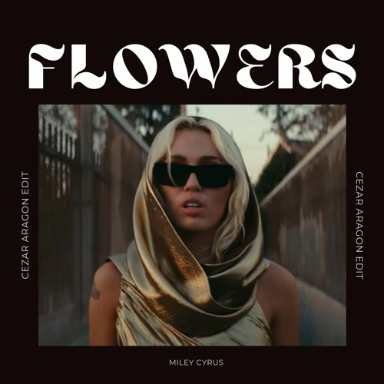
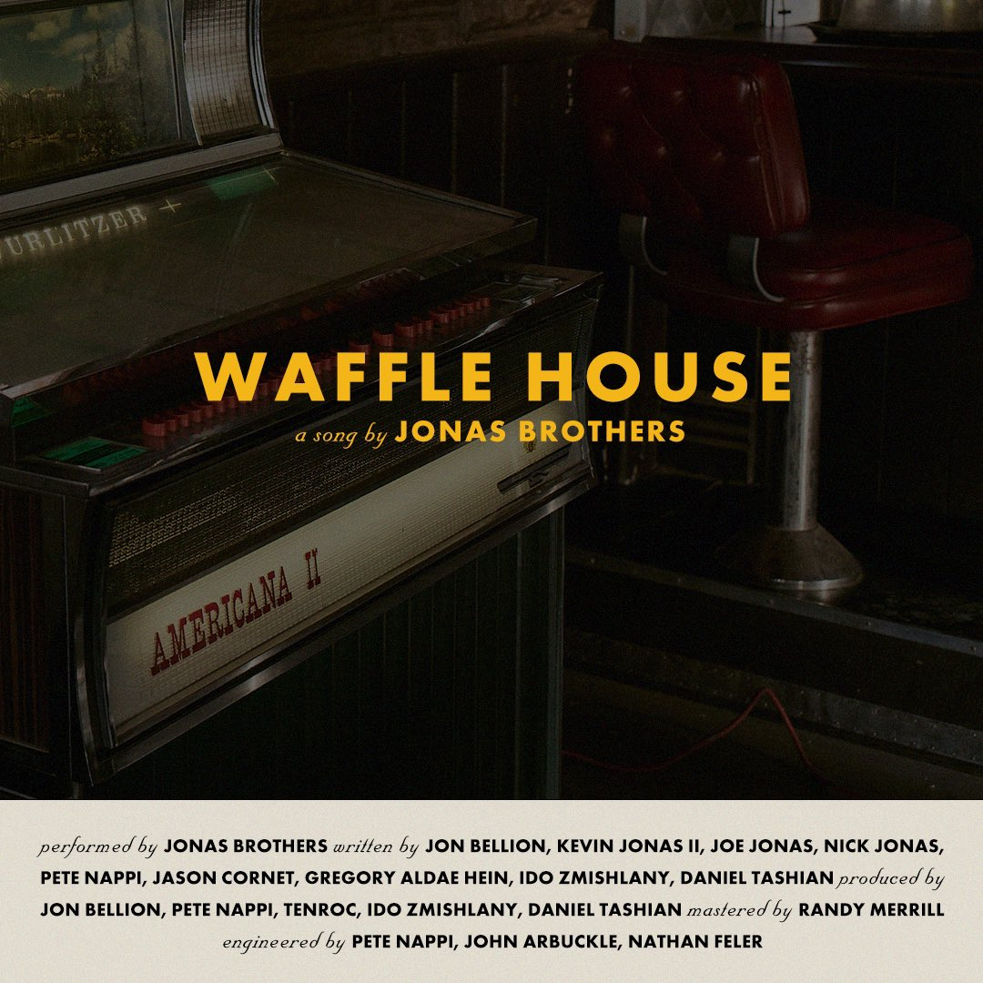
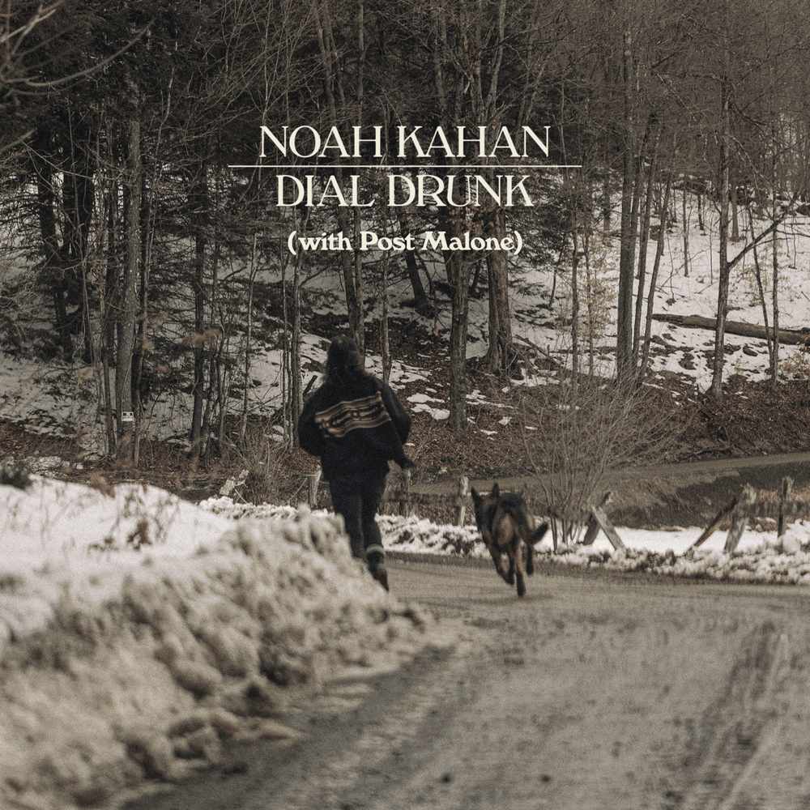



WANT MORE ‘HOT’ SONGS?

Slide 5





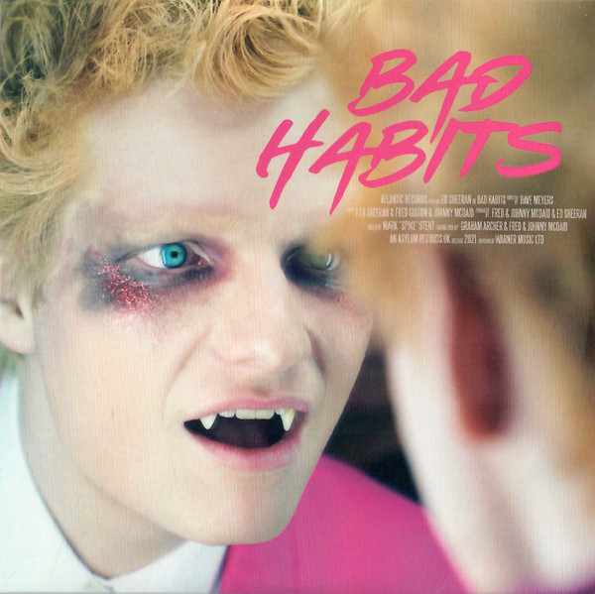
DO YOU HAVE A NOT ‘HOT’ SONG TASTE?

Slide 6
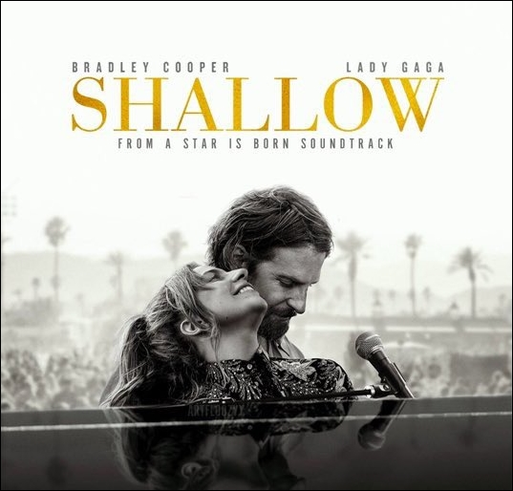


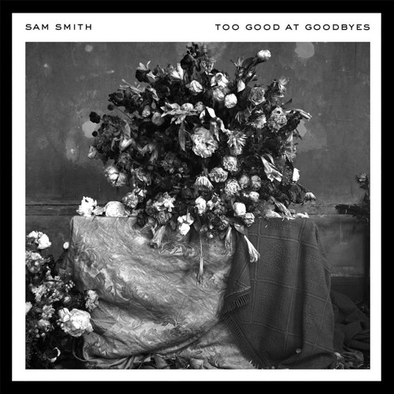


IS YOUR SONG NOT IN OUR DATABASE? NO WORRIES!

Slide 7
WHAT SETS SOUNDGPT APART?
 | SoundGPT | SpotiFind | AppleQuest
INTERACTIVE INTERFACE
INDEPENDENT
CARBON NEUTRAL |  | d

Slide 8
WHAT DO OUR USERS
HAVE TO SAY
Tom Holland
Beyonce
"SoundGPT is my creative muse. Its impeccable recommendations inspire me to explore new rhythms and genres, shaping my music into an ever-evolving symphony of self-expression. It's my secret weapon and an essential part of my journey as an artist."
"When I'm swinging through the city as Spider-Man, I need the perfect music to match the adrenaline rush. SoundGPT nails it every time! It's like having my personal DJ, and the recommendations are always spot on. Trust me, you won't want to save the world without SoundGPT in your ear!"

Slide 9
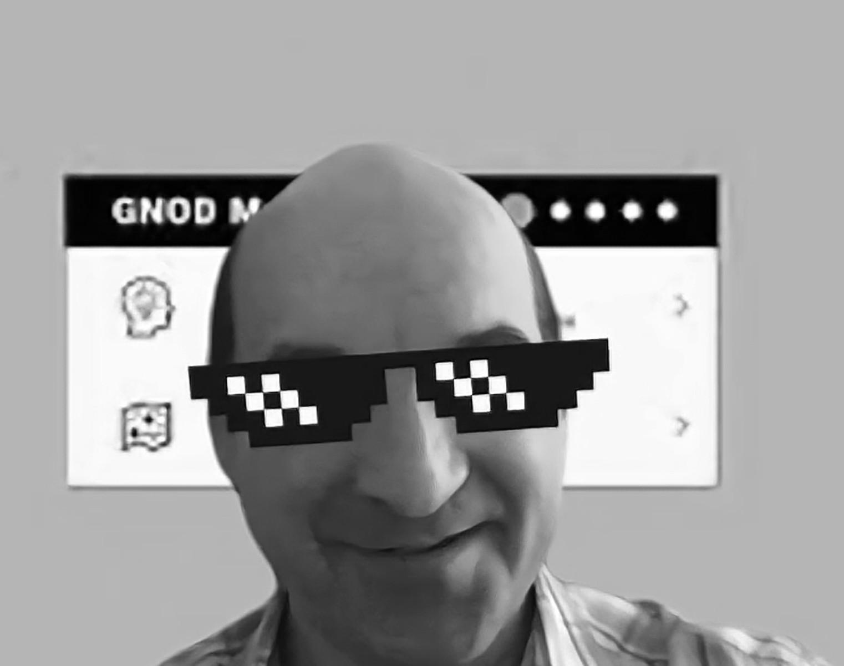
Set the trend, make music soar, with SoundGPT, you'll beg for more!

Slide 10
DEMONSTRATION

Slide 11
THANKS
Do you have any questions?
therearedumbquestions@opensound.com
+49 620 421 838
opensound.com/soundgpt
Please keep this slide for attribution

